Slide 1
Smart Garbage Management
Team sddecc18-08
Colin McAllister, Nicholas Pecka, Robert Duvall, Steven Brown, Brendan Finan, and Samuel Johnson
Advisor Goce Trajcevski
http://sddec18-08.sd.ece.iastate.edu/

Slide 2
Problem
254 million tons of garbage created in the USA in 2013
Garbage routing is static and does not factor dynamic customer behavior
Does not account for an individual customer’s needs
Cannot accurately predict when a truck will become full
Solution
Smart garbage bin
Measures garbage height & weight and uploads to cloud
Smart routing
Creates efficient collection routes based on collected data
Resident and waste management applications
Allows waste management to view smart routes
Gives customers insight into their waste disposal habits

Slide 3
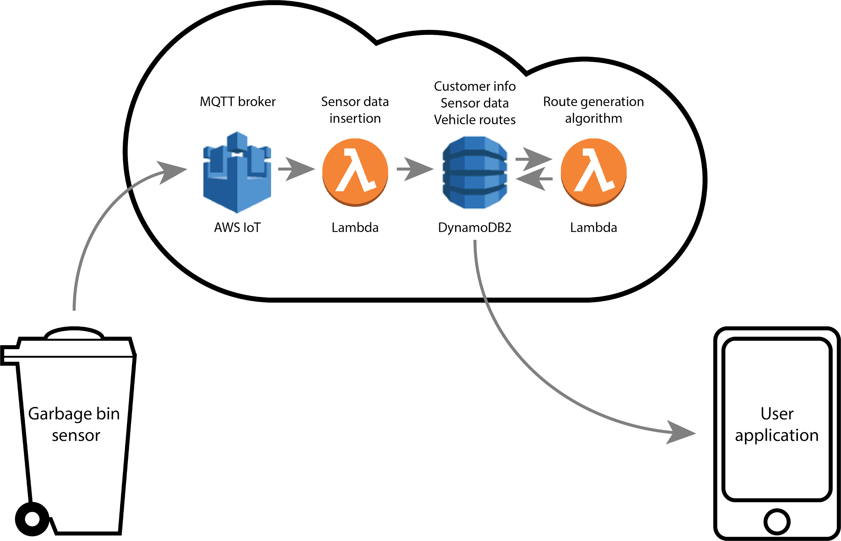
Basic Modules

Slide 4
Functional Requirements
Trash bin device must determine approximate weight and height of contents
Garbage sensor communication
Secure
Verifiable
Guaranteed to reach cloud
Collection routes must use less fuel than a naive route
Generated routes will accurately predict when garbage trucks will be filled
Notes:
Sam

Slide 5
Non-functional Requirements
Scalability
Capable of incorporating a large number of garbage sensors
Heterogeneity
Able to seamlessly integrate multiple waste management clients into the service
Usability
Product simple to use and install
Data security
All communication must use end to end encryption
Protect user data
Notes:
Sam

Slide 6
Constraints
Residents are not used to charging their garbage cans
High capacity battery
Efficient power usage
Solar panels
Cost
Residents
Not willing to spend substantially more money on waste management
Waste Management Companies
Cost of implementation must be reasonable compared to return on investment
Notes:
RJ

Slide 7
Potential Risks
Data Leaks
Network vulnerabilities
Data center breaches
Defective garbage sensors
Damaged sensors
Power loss
Stolen garbage bins
Consumer misuse
Device tampering
Notes:
Sam

Slide 8
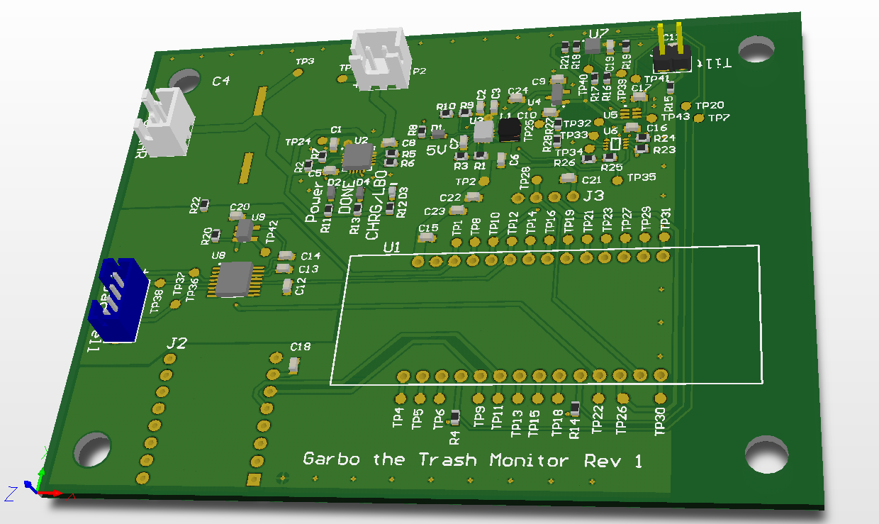
Garbage Bin Sensor
Notes:
Colin

Slide 9
Sensor Considerations
Low power
Standalone device
Must be able to sustain operability for several weeks without charge
Low cost
Device cost must be feasible to deploy
I/O Limits
Limited number of GPIO pins on Pycom FiPy development board
Durability
Adhere to Outdoor/Automotive temperature and vibration standards
Notes:
Colin

Slide 10
Sensor Overview
Retrofittable to lid of standard residential garbage containers
Lower installation cost
Lid movement wakes device from low power sleep mode
Powered by lithium cell with multiple charging options
Charge over USB for programming and device configuration
Charges via solar cell on top of garbage container
Interfaces with load cell attached to bottom of container
Measures weight, a critical metric for garbage collection but complicates installation
Wirelessly transmits to Amazon Web Services’ Internet of Things Core
Notes:
Colin

Slide 11
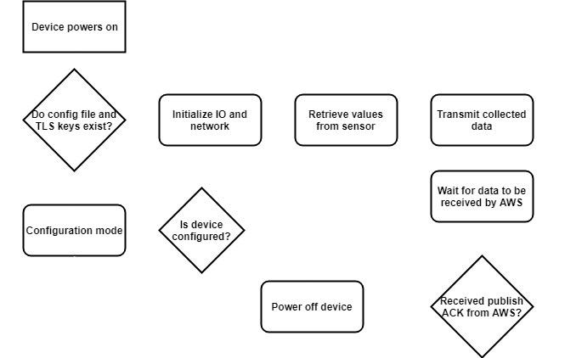
Sensor State Diagram
Notes:
Colin

Slide 12
Sensor Communication
Communication layer
LTE CAT M1
Low power characteristics satisfies energy efficiency requirements
Features include long range communication and high building penetration
Transport layer
Message Queuing Telemetry Transport (MQTT)
Encrypted over Transport Layer Security (TLS) connection
Sends JSON packet containing location, trash measurements, and measurement time
Brokered by AWS IoT Core
Invokes Lambda function that places measurements in DynamoDB table
Notes:
Colin

Slide 13
Sensor Circuit Board Design
MCP73871 battery charger
Used to charge lithium cell and power board via solar or USB power
TPS63701 buck-boost switched mode power supply
Regulates battery or MCP73871 load voltage to 5 volts for Pycom FiPy
Custom ultra-low power sleep mode
Accelerometer interrupt or tilt switch detects lid movement and sets TinyLogic latch
The latch enables switched mode power supply
FiPy board re-enters sleep mode by clearing the latch
Headers for GPS, ultrasonic sensor, and Pycom FiPy development board
Manufactured using low-cost two-layer 6/6 mil 1 oz copper board process
Notes:
Steven

Slide 14
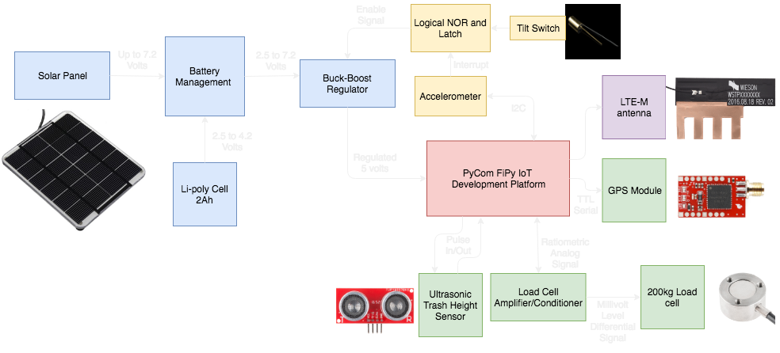
Sensor Hardware System Diagram
Notes:
Steven
Broad Strokes

Slide 15
Sensor Testing
Board testing
Tested for shorts or faults in manufacturing
Verified battery manager and voltage regulator worked correctly
Ensured sleep circuit behaved as intended
Power testing
Calculated by measuring active and sleep current consumptions
Results estimated a lifetime of 7 to 11 weeks off 2,000 mAh battery
Software testing
Individually tested software modules that interacted each sensor
Integration testing
Ensured final software ran on Pycom FiPy board when attached to prototype
Tested communication from garbage sensor to AWS IoT Core
Notes:
Steven

Slide 16
Vehicle Routing
Notes:
Transition to Sam

Slide 17
Routing
Model
Select garbage bins that are full enough to warrant pick up
Use those bins as nodes in a vehicle routing program
Use a genetic algorithm to build a route in that solves the vehicle routing problem
Genetic Algorithm
Builds a population of random routes
Repeatedly builds new generations of routes through selection and merging
After a user set number of generations, select the best available routes
Notes:
Sam

Slide 18
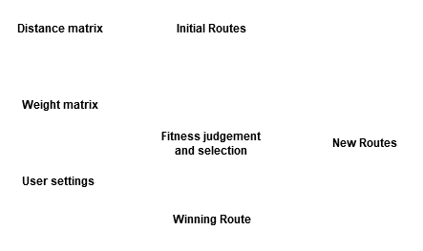
Routing
Notes:
Sam

Slide 19
Routing Testing
All tests used a population of 200 chromosomes, ran for 25 generations, and were tested 1000 times
Test 1 (Simple Human Solvable Traveling VRP): 100%
Test 2 (One Linear Cluster, One Truck): 100%
Test 3 (Two Linear Clusters, Two Trucks): 98.7%

Slide 20
Mobile Application

Slide 21
Mobile Application
Bin Monitoring
Routing Interface
Resident - Collector communication
Notes:
Brendan

Slide 22
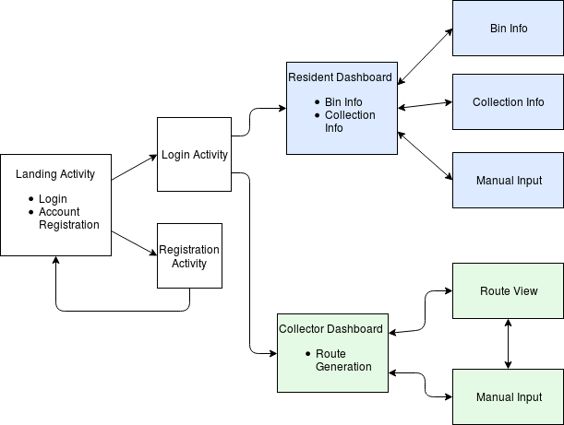
Notes:
Brendan
Bigger Diagram
Decrease android

Slide 23
Validation
Garbage bin sensor
Ensured power demands would satisfy lifetime requirements
Tested ultrasonic sensor and load cell for accuracy
Verified data was measured and stored in database
Vehicle routing algorithm
TODO
User application
TODO
Notes:
nick
Several main units - Sensors, routing algorithm

Slide 24
Current Project Status
Spring 2018 Milestones
Integrated Sensor Testing
Communications Testing
Homeowner App Frame
Clustering Tests
Fall 2018 Milestones
Completed garbage sensor prototype with full AWS integration
TODO

Slide 25
Future Work
Create second garbage sensor prototype
Focus on continuing to lower power constraints and lower costs
Integrate MCU, wireless modem, GPS, and ultrasonic sensor onto single board
Finalize load cell fixture and board enclosure
Weatherproofing board and conducting vibration testing
Load testing AWS services
TODO
Notes:
RJ

Slide 26
Thank you

Slide 27
Individual Responsibilities and Contributions
Robert: AWS Lambda Functions and OSM Route Creation.
Colin: Garbage sensor design and software development
Nicholas: Researching and assisting with Mobile Application
Samuel: Routing and Clustering Logic
Steven: Component integration, board design, and power management
Brendan: Mobile Application
Notes:
RJ

Slide 28
Appendix: Project Costs
Hardware Prototype | $140/Device
Cellular Subscription | $16/Year/Device
Software Backend Costs | $480/Year/Municipality
Notes:
Steven
Brief

Slide 29
Appendix: Garbage Sensor Power Test Results
Minimum consumption percentage | 17.16 mAh / week
Maximum consumption percentage | 22.2 mAh / week
Maximum estimated lifetime | 5.8 weeks
Minimum estimated lifetime | 4.5 weeks

Slide 30
Appendix: Circuit Board Schematic

Slide 31
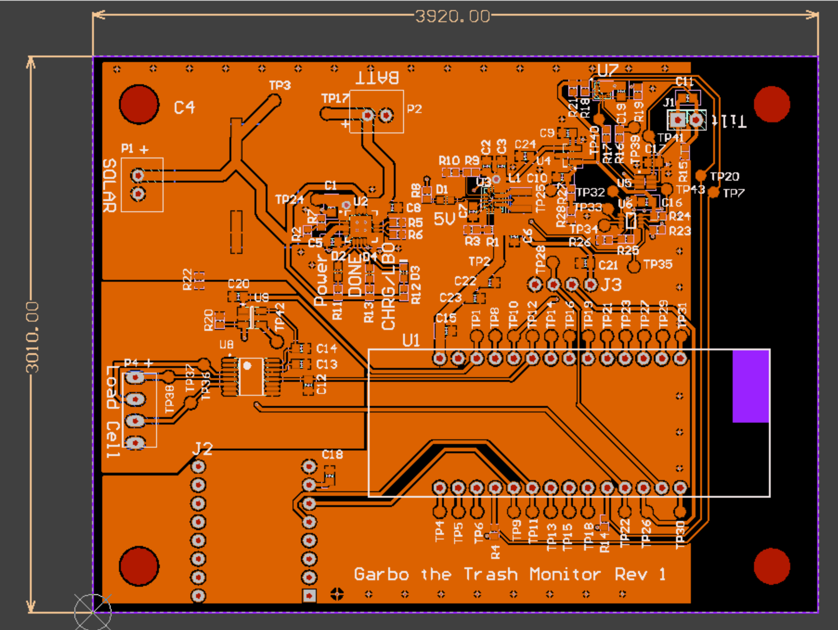
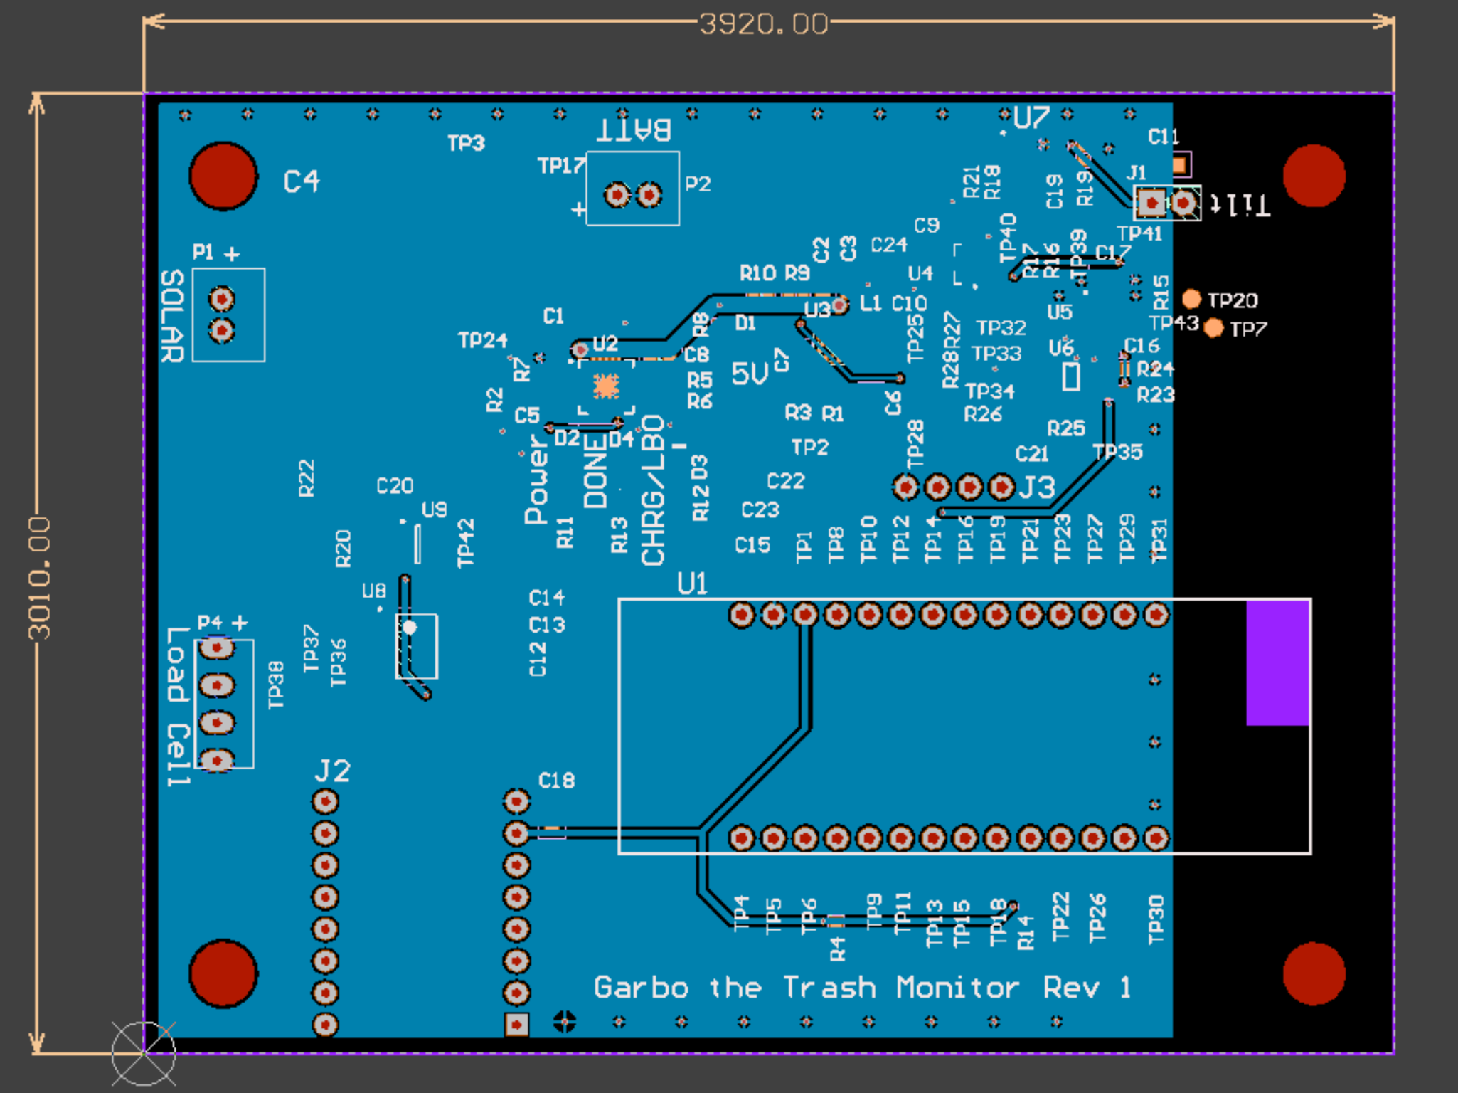
Appendix: Circuit Board Details
Top Layer
Bottom Layer

Slide 32
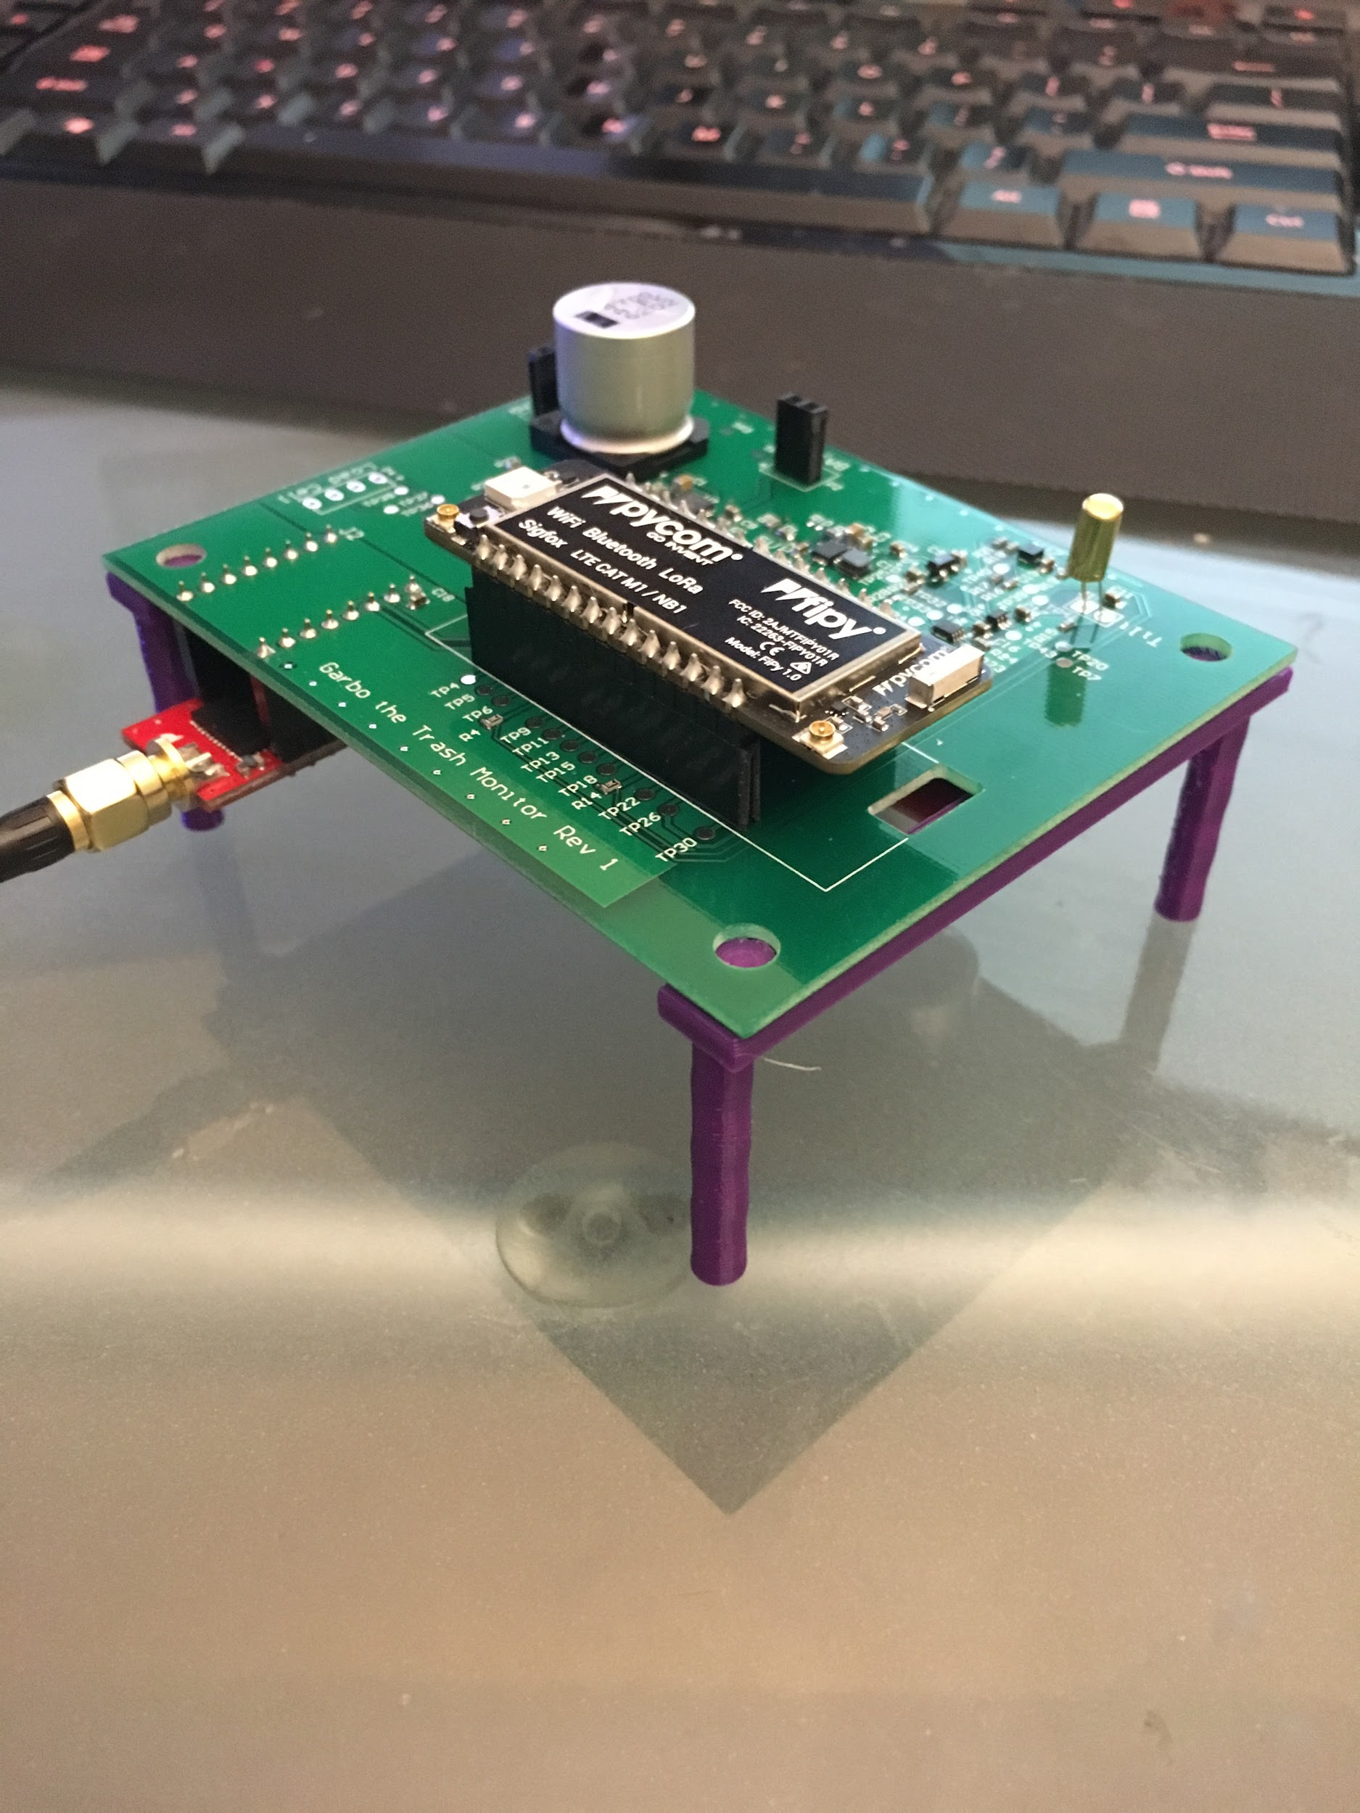
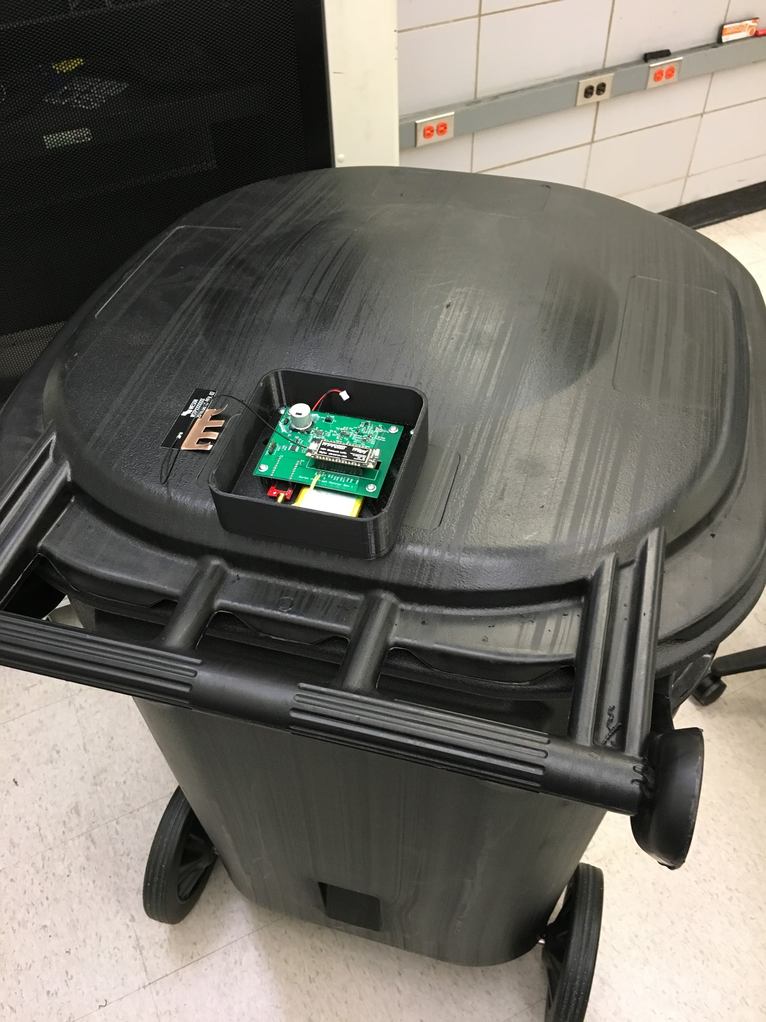
Appendix: Garbage Sensor Prototype

